Slide 1
Introduction
Kellie Koedel
MH Companies

Slide 2
Agenda
FHWA ruling – motivation for change
Review AASHTO
  What’s new for 2015!
Why Fatigue Categories Matter
  Importance Factor
Examples
Don’t let your engineered drawings get copied
How to write a spec
  Valmont only for government
Cost difference current, 2015 FC1, 2015 FC2 mitigator

Slide 3


Slide 4
AASHTO
Denver: 2001, FC2 no galloping. 100MPH

Slide 5
FHWA Final Ruling:
Department of Transportation, Federal Highway Administration 23 CFR Part 625
  Final Ruling - Required design standards on Federal-aid highway projects…..AASHTO LTS6 - 2013
  Effective Date for New Projects after November 12, 2015
  The rule is not retroactive to current projects.

Slide 6
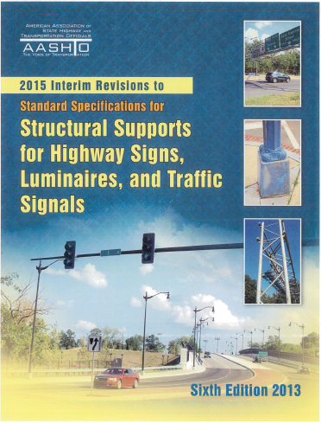
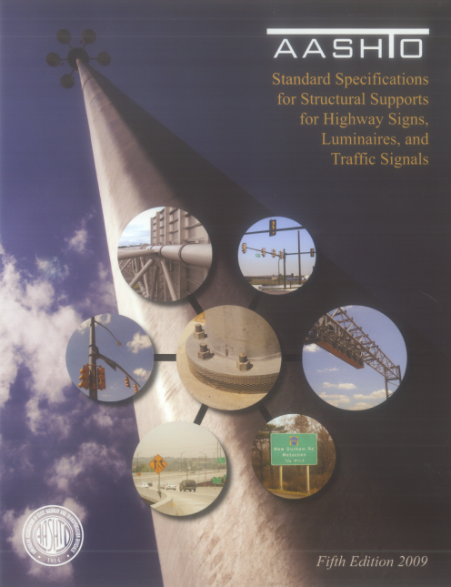
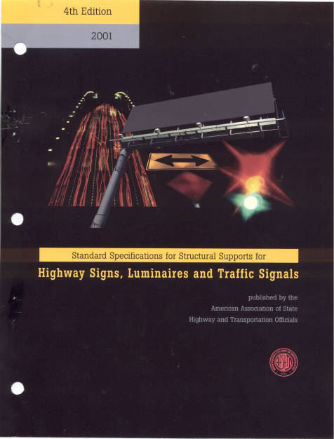
The AASHTO Evolution:
2001 – Changed from Fastest Mile to 3 Second Gust Wind Loading
2001 - Fatigue Design Introduced (Section 11)
2013 – Minimum Required design standards on Federal-aid highway projects
2015 – Load Resistance Design Factor (ultimate wind) Introduced
Standard Specifications for Structural Supports for Highway Signs, Luminaires and Traffic Signals
1994
Standard Specifications for Structural Supports for Highway Signs, Luminaires and Traffic Signals
1984
Standard Specifications for Structural Supports for Highway Signs, Luminaires and Traffic Signals
1975
2015
2013
2009
2001
1994
1984
1975

Slide 7
Fatigue Category - AASHTO 2001:
Choosing a Fatigue Category (AASHTO 2001 C11.6):
  Fatigue Category I: Most Stringent
    High Hazard in the event of failure and should be designed to resist rarely occurring wind loading and vibration phenomena.
    The most Critical cantilevered support structures.
    Large sign structures, Variable message sign (VMS), Traffic Structures with long arms, High level lighting structures in excess of 98 feet that are installed on highways where the vehicle speed is such that the consequences of excessive deflection or collision with a fallen structure is intolerable.
  Fatigue Category III: Least Stringent
    Structures less likely to experience the full limit state wind loads associated with Category I.
  Fatigue Category II:
    Structures less likely to experience the full limit state wind loads associated with Category I.

Slide 8
Fatigue Category - AASHTO 2013 & 2015:
Choosing a Fatigue Category (AASHTO 2013/2015 C11.6):
  Fatigue Category I: Most Stringent
    AASHTO Recommends that all Structures without effective mitigation devices on roadways with a speed limit in excess of 35 mph and ADT exceeding 10,000, or ADTT exceeding 1,000 be designed to Fatigue Category I.
    Cantilevered sign structures without mitigation devices with a span in excess of 50 feet be designed to Fatigue Category I.
    Large sign structures, both cantilevered and non-cantilevered, including variable message signs, without mitigation devices be designed to Fatigue Category I.
    Structures without mitigation devices located in an area that is known to have wind conditions that are conducive to vibrations be designed to Fatigue Category I.
    Structures classified as Category I should be designed to resist rarely occurring wind loading and vibration phenomena.
  Fatigue Category III: Least Stringent
    Structures located on roads with speed limits of 35 mph or less.
    Structures that are located such that a failure will not affect traffic.
  Fatigue Category II:
    All structures not explicitly meeting the Category I or Category III criteria.
Note:
Quantifies FC1
References
mitigation device
*kk - road design avg is 1900 per lane per hour

Slide 9
2013 vs 2015
2013 uses the old design method and wind maps. Will be more familiar to traffic engineers
2015 uses the new LRFD (Load Resistance Design Factor) and Ultimate wind
  Newer AASHTOs coming will be based on LRFD so 2015 will be more current longer

Slide 10
55’ Mast Arm Example
 | Pole |  |  | Arm
 | Diameter (in.) | Thickness (in.) | Length (ft.) | Diameter (in.) | Thickness (in.) | Length (ft.) | Total Weight (shafts, baseplate flanges) | % Weight Change
2001 Design | 15 | 0.3125 | 39 | 14.75 | 0.3125 | 55 | 3,792
2013 // FC 1 // Gal | 19.5 | 0.3125 | 39 | 22 | 0.5 | 55 | 7,449 | 96%
2013 // FC 2 // Gal | 19.5 | 0.3125 | 39 | 18 | 0.3125 | 55 | 5,071 | 34%
2013 // FC 2 // with TR1 for Gal | 16 | 0.3125 | 39 | 14.5 | 0.3125 | 55 | 3,457 | -9%
 | Baseplate |  |  |  |  | Anchor Bolts
 | Square (in.) | Bolt Circle (in.) | Thickness (in.) | Center Hole Diameter (in.) | Baseplate Weight (lbs) | Diameter (in.) | Quantity
2001 Design | 20 | 20 | 1.75 | 8 | 180 | 2 | 4
2013 // FC 1 // Gal | 30.5 x 27.25 | 24.88 | 3 | 10 | 633 | 2.25 | 6
2013 // FC 2 // Gal | 26.5 | 26.5 | 2 | 10.75 | 350 | 2.25 | 4
2013 // FC 2 // with TR1 for Gal | 22.5 | 22.5 | 2 | 13 | 210 | 2 | 4
Fatigue Category 2 justified with use of mitigation device

Slide 11
Fatigue Loads:
Galloping Loads (Section 11.7.1.1)
Truck-Induce Loads (Section 11.7.1.3)
Galloping and Truck-Induced Loads Recommended Deflection Requirements (Section 11.8)
High Mast (Natural Wind and Vortex Shedding Combination) (Section 11.7.2)
Vortex Shedding
Natural Wind Gusts (Section 11.7.1.2)

Slide 12
Galloping Loads:
P_{G}= 21(I_{F})
F_{G}= P_{G}(A)
Where:
P_{G} = Vertical shear pressure range
I_{F} = Importance Factor
F_{G} = Galloping Force Load
A = Frontal Project Area of Signs and Signals
  Importance Factors, I_{F}
    Category I: I_{F} = 1.0
    Category II: I_{F} = 0.65 Traffic or 0.70 Sign
    Category III: I_{F} = 0.30 Traffic or 0.40 Sign
Galloping (AASHTO 2013/2015 11.7.1.1):
  All Category I Structures should be designed to resist Galloping Forces, unless an effective mitigation device is installed. (C11.6)
  No Galloping Loads when an effective mitigation device is installed.
  For Traffic Signal Poles, the Owner may choose to install an effective mitigation device when a structure displays a galloping problem and it should be installed as quickly as possible.

Slide 13
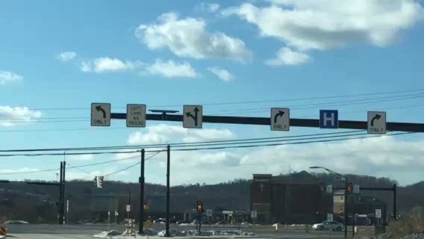
Galloping Loads:
Pennsylvania Mast Arm

Slide 14
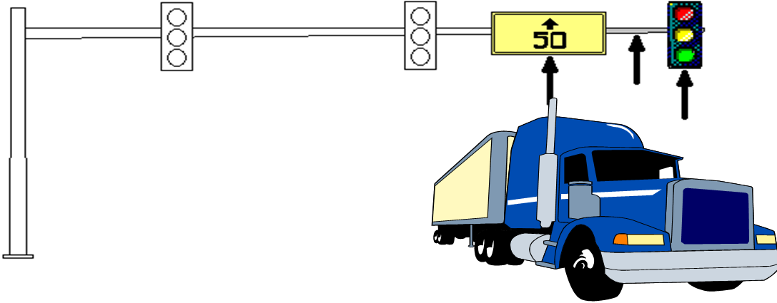
Truck-Induced Loads:
P_{TG}= 18.8(C_{d})(I_{F})
F_{TG}= P_{TG}(A)
*accounts for 1 12’ section
Where:
P_{TG} = Static truck gust pressure range (12 foot worst case range)
I_{F} = Importance Factor
C_{d} = Drag Coefficient based on 65mph vehicle speed
F_{TG} = Truck gust Force Load
A = Bottom Project Area of Signs and Signals and Arm
Importance Factors, I_{F}
  Category I: I_{F} = 1.0
  Category II: I_{F} = 0.85 Traffic or 0.90 Sign
  Category III: I_{F} = 0.70 Traffic or 0.80 Sign
Truck-Induced (AASHTO 2013/2015 11.7.1.3):
  Applies to all Cantilevered and non-cantilevered sign and traffic signal structures.
  All Category I Structures should be designed to resist rarely occurring vibration phenomena. (C11.6)
  The truck-induced gust loading shall be excluded, unless required by the Owner for traffic signal structures.

Slide 15
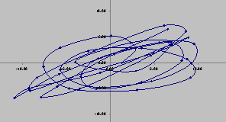
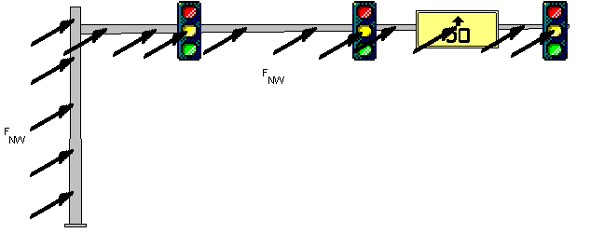
Natural Wind Gusts:
P_{NG} = 5.2(C_{d})(I_{F})
F_{NG} = P_{TG}(A)
Importance Factors, I_{F}
  Category I: I_{F} = 1.0
  Category II: I_{F} = 0.80 Traffic or 0.85 Sign
  Category III: I_{F} = 0.55 Traffic or 0.70 Sign
Where:
P_{NG} = Natural wind gust pressure range
I_{F} = Importance Factor
C_{d} = Drag Coefficient based on 11.2 mph wind speed
F_{NG} = Natural wind gust force load
A = Frontal Project Area of Signs and Signals and Arm & Pole
Natural Wind Gust (AASHTO 2013/2015 11.7.1.2):
  Cantilevered and non-cantilevered over head sign and traffic signal supports shall be designed to resist Natural Wind Gust Loads.
  No Natural Gust Loading exclusion when using a mitigation device.

Slide 16

The Valmont Solution:

Slide 17
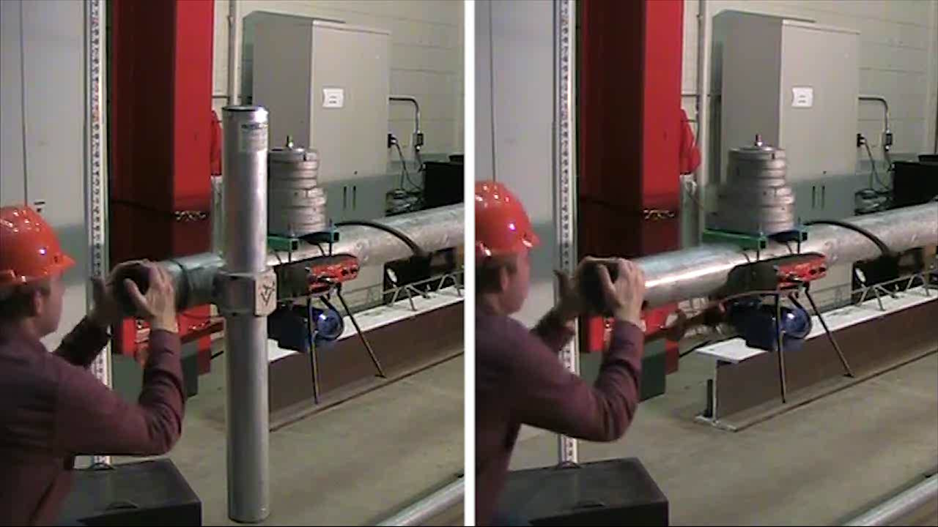
Testing at UCONN
Free Vibration Test (50’ Lg Arm w/125 lbs. Mass - 0.99 Hz)
Slender 50 foot mast arm
Undampened
Dampened

Slide 18
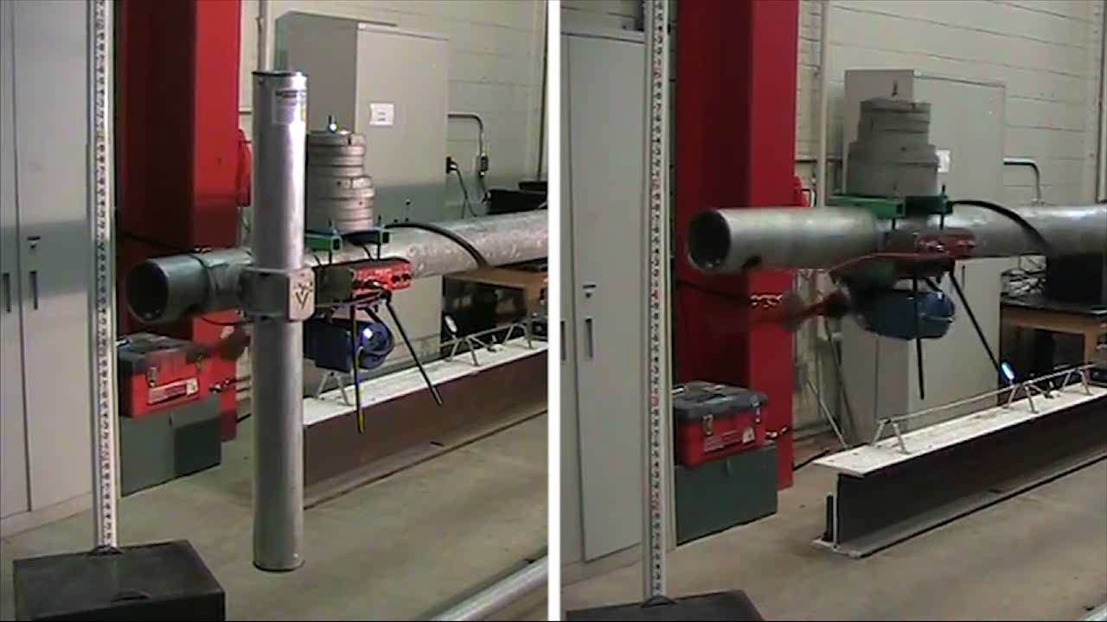
Testing at UCONN
Forced Vibration Test (50’ Lg Arm w/125 lbs. Mass - 0.99 Hz)
Slender 50 foot mast arm
Undampened
Dampened

Slide 19
55’ Mast Arm Example
 | Pole |  |  | Arm
 | Diameter (in.) | Thickness (in.) | Length (ft.) | Diameter (in.) | Thickness (in.) | Length (ft.) | Total Weight (shafts, baseplate flanges) | % Weight Change
2001 Design | 15 | 0.3125 | 39 | 14.75 | 0.3125 | 55 | 3,792
2013 // FC 1 // Gal | 19.5 | 0.3125 | 39 | 22 | 0.5 | 55 | 7,449 | 96%
2013 // FC 2 // Gal | 19.5 | 0.3125 | 39 | 18 | 0.3125 | 55 | 5,071 | 34%
2013 // FC 2 // with TR1 for Gal | 16 | 0.3125 | 39 | 14.5 | 0.3125 | 55 | 3,457 | -9%
Fatigue Category 2 justified with use of mitigation device
 | Baseplate |  |  |  |  | Anchor Bolts
 | Square (in.) | Bolt Circle (in.) | Thickness (in.) | Center Hole Diameter (in.) | Baseplate Weight (lbs) | Diameter (in.) | Quantity
2001 Design | 20 | 20 | 1.75 | 8 | 180 | 2 | 4
2013 // FC 1 // Gal | 30.5 x 27.25 | 24.88 | 3 | 10 | 633 | 2.25 | 6
2013 // FC 2 // Gal | 26.5 | 26.5 | 2 | 10.75 | 350 | 2.25 | 4
2013 // FC 2 // with TR1 for Gal | 22.5 | 22.5 | 2 | 13 | 210 | 2 | 4

Slide 20
30’
Current: 2001, FC2 no galloping
VALMONT INDUSTRIES
AASHTO 100mph FC1 & FC2 Comparisons |  |  |  |  |  |  |  | 1/29/2018
30' MAST ARM | 1-piece
 | Fatigue Category | Galloping Included | Truck Gust Included (45 MPH) | Wind Load Included | Pole Base Size & thickness | # anchor bolt | anchor bolt size | mast arm base and thickness | arm connection simplex size | # connection bolt | connection bolt size | weight (lbs) | weight difference
2001 Current Design | 2 | NO | YES | YES | 15.5 (.2188) | 4 | 2 | 12 (.2092) | 21.75 sq | 4 | 1.5 | 2013
2013 AASHTO FC1 Galloping | 1 | YES | YES | YES | 16.5 (.25) | 4 | 2 | 14.9 (.25) | 22.25 sq | 4 | 1.5 | 2685 | 33.4%
2013 AASHTO FC2 galloping | 2 | YES | YES | YES | 15 (.1875) | 4 | 2 | 12.5 (.2391) | 20.25 sq | 4 | 1.25 | 1959 | -2.7%
2013 AASHTO FC2 TR1 For galloping | 2 | DEFAULT | DEFAULT | YES | 15 (.1875) | 4 | 2 | 10 (.1793) | 20.25 sq | 4 | 1.25 | 1618 | -19.6%
 |  |  |  |  |  |  |  |  | *MUST MEET HANDHOLE CRITERIA FOR AASHTO 2013

Slide 21
50’
X
50' MAST ARM | 2-piece |  |  |  |  |  |  |  |  |  |  | wgt | wgt
 | Fatigue Category | Galloping included | Truck Gust Included | Wind Load Included | Pole Base Size & thickness | # anchor bolt | anchor bolt size | mast arm base and thickness | arm connection simplex size | # connection bolt | connection bolt size | weight (lbs) | weight difference
2001 Current Design | 2 | NO | YES | YES | 17 (.2188) | 4 | 2 | 15 (.25) | 23.25 sq | 4 | 1.5 | 2933
2013 AASHTO FC1 Galloping | 1 | YES | YES | YES | 21 (.375) | 4 | 2 | 18.5 (.3125) | 29.50 sq | 8 | 1.5 | 5270 | 79.7%
2013 AASHTO FC2 galloping | 2 | YES | YES | YES | 18 (.25) | 4 | 2 | 16.5 (.25) | 23.75 sq | 4 | 1.25 | 3442 | 17.4%
2013 AASHTO FC2 TR1 For galloping | 2 | DEFAULT | DEFAULT | YES | 17 (.2188) | 4 | 2 | 15 (.25) | 23.25 sq | 4 | 1.25 | 2933 | 0.0%
 |  |  |  |  |  |  |  |  | *MUST MEET HANDHOLE CRITERIA FOR AASHTO 2013
Used Current DB00714 Standard Loadings

Slide 22
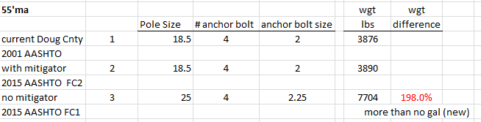
Don’t hand out too much info
Material cost difference
basis
10% higher
50% higher

Slide 23
Drawings
New TK drawing
Take out the engineering secrets but keep the pertinent info the customer needs.
Spec in stamped letter will work for approval
  Conversation to explain how our industry works and trade secrets

Slide 24
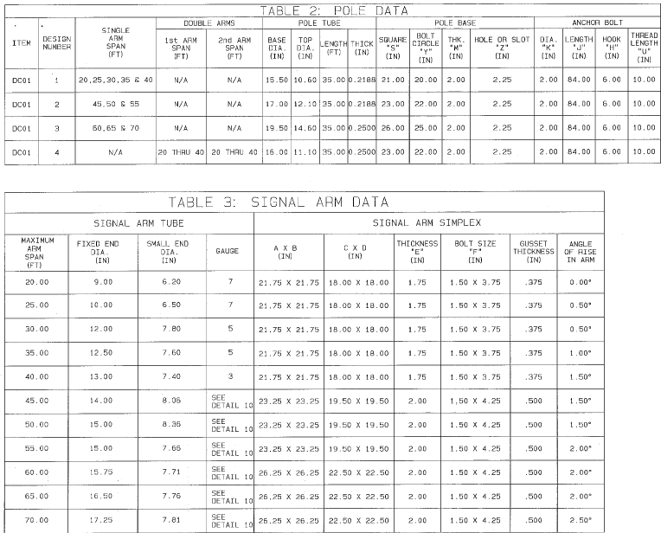
DB Drawing

Slide 25
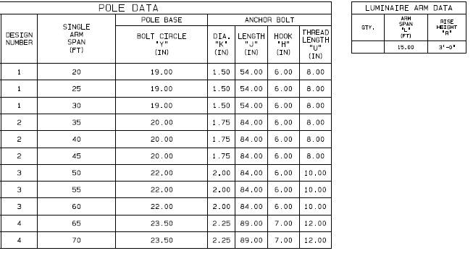
TK drawing (same drawing #)

Slide 26
How to Write a Spec
Anyone can submit a 2015 compliant design.
  We are the only ones with a mitigation device
Have a list of currently approved devices
Mitigation devices must have prior approval from city
Liability that all parts come from one manufacturer

Slide 27

Written Spec
**if handing out stamped drawings mark them proprietary

Slide 28
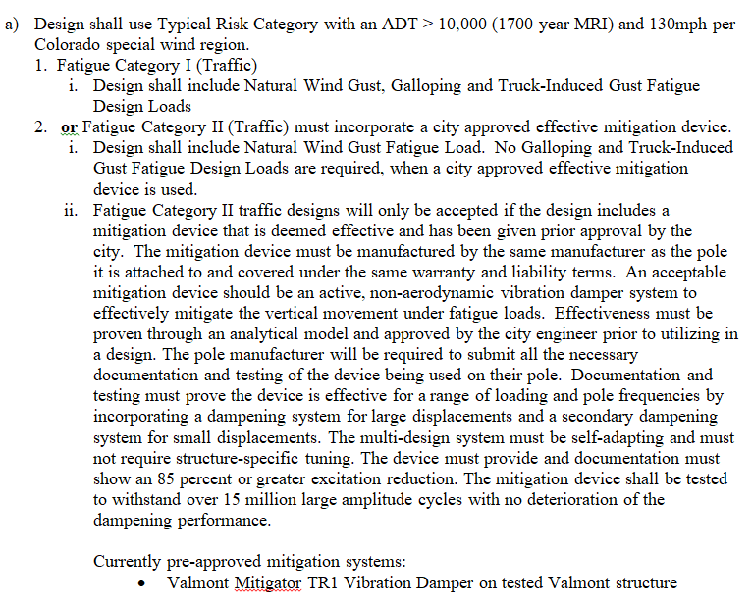
Written Spec

Slide 29
THANK YOU!
valmontstructures.com
Kellie Koedel
MH Companies
720-989-0066

